Slide 1

Collision Detection
CSE169: Computer Animation
Instructor: Steve Rotenberg
UCSD, Winter 2005

Slide 2
Collisions
Collision Detection
  Collision detection is a geometric problem
  Given two moving objects defined in an initial and final configuration, determine if they intersected at some point between the two states
Collision Response
  The response to collisions is the actual physics problem of determining the unknown forces (or impulses) of the collision

Slide 3
Collision Detection

Slide 4
Collision Detection
‘Collision detection’ is really a geometric intersection detection problem
Main subjects
  Intersection testing (triangles, spheres, lines…)
  Optimization structures (octree, BSP…)
  Pair reduction (reducing N² object pair testing)

Slide 5
Intersection Testing
General goals: given two objects with current and previous orientations specified, determine if, where, and when the two objects intersect
Alternative: given two objects with only current orientations, determine if they intersect
Sometimes, we need to find all intersections. Other times, we just want the first one. Sometimes, we just need to know if the two objects intersect and don’t need the actual intersection data.

Slide 6
Primitives
We often deal with various different ‘primitives’ that we describe our geometry with. Objects are constructed from these primitives
Examples
  Triangles
  Spheres
  Cylinders
  AABB = axis aligned bounding box
  OBB = oriented bounding box
At the heart of the intersection testing are various primitive-primitive tests

Slide 7
Particle Collisions
For today, we will mainly be concerned with the problem of testing if particles collide with solid objects
A particle can be treated as a line segment from it’s previous position to it’s current position
If we are colliding against static objects, then we just need to test if the line segment intersects the object
Colliding against moving objects requires some additional modifications that we will also look at

Slide 8
Basic Components
class Segment {
Vector3 A,B;
};
class Intersection {
Vector3 Position;
Vector3 Normal;
Material *Mtl; (Mtl can contain info about
elasticity, friction, etc)
};

Slide 9
Primitives
class Primitive {
virtual bool TestSegment(const Segment &s,
Intersection &i);
};
class Sphere:public Primitive…
class Triangle:public Primitive…
class Cylinder:public Primitive…

Slide 10

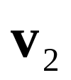

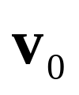


Segment vs. Triangle
Does segment ab intersect triangle v₀v₁v₂ ?
•

Slide 11
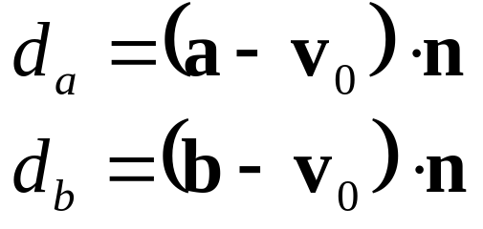



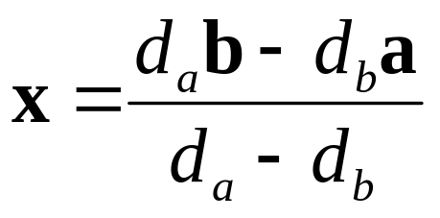
Segment vs. Triangle
First, compute signed distances of a and b to plane
Reject if both are above or both are below triangle
Otherwise, find intersection point x
•

Slide 12
Segment vs. Triangle
Is point x inside the triangle?
(x-v₀)·((v₂-v₀)×n) > 0
Test all 3 edges
v₂
v₂-v₀
x-v₀
x
•
v₀
v₁
(v₂-v₀)×n

Slide 13
Faster Way
Reduce to 2D: remove smallest dimension
Compute barycentric coordinates
x' =x-v₀
e₁=v₁-v₀
e₂=v₂-v₀
α=(x'×e₂₎/(e₁×e₂)
β=(x'×e₁₎/(e₁×e₂)
Reject if α<0, β<0 or α+β >1
v₂
β
x
v₀
α
v₁

Slide 14
Segment vs. Mesh
To test a line segment against a mesh of triangles, simply test the segment against each triangle
Sometimes, we are interested in only the ‘first’ hit along the segment from a to b. Other times, we want all intersections. Still other times, we just need any intersection.
Testing against lots of triangles in a large mesh can be time consuming. We will look at ways to optimize this later

Slide 15
Segment vs. Moving Mesh
M₀ is the object’s matrix at time t₀
M₁ is the matrix at time t₁
Compute delta matrix:
M₁=M₀·M_{Δ}
M_{Δ}= M₀⁻¹·M₁
Transform a by M_{Δ}
a'=a·M_{Δ}
Test segment a'b against object with matrix M₁

Slide 16
Triangle vs. Triangle
Given two triangles: T₁ (u₀u₁u₂) and T₂ (v₀v₁v₂)
v₂
u₂
v₀
T₂
T₁
u₀
v₁
u₁

Slide 17
Triangle vs. Triangle
Step 1: Compute plane equations
n₂=(v₁-v₀)×(v₂-v₀)
d₂=-n₂·v₀
v₂
v₂-v₀
n
v₁
v₀
v₁-v₀

Slide 18
Triangle vs. Triangle
Step 2: Compute signed distances of T₁ vertices to
plane of T₂:
d_{i}=n₂·u_{i}+d₂ (i=0,1,2)
Reject if all d_{i}<0 or all d_{i}>0
Repeat for vertices of T₂ against plane of T₁
u₀
d₀

Slide 19
Triangle vs. Triangle
Step 3: Find intersection points
Step 4: Determine if segment pq is inside triangle or intersects triangle edge
q
p

Slide 20
Mesh vs. Mesh
Geometry: points, edges, faces
Collisions: p2p, p2e, p2f, e2e, e2f, f2f
Relevant ones: p2f, e2e (point to face & edge to edge)
Multiple simultaneous collisions

Slide 21
Moving Mesh vs. Moving Mesh
Two options: ‘point sample’ and ‘extrusion’
Point sample:
  If objects intersect at final positions, do a binary search backwards to find the time when they first hit and compute the intersection
  This approach can tend to miss thin objects
Extrusion:
  Test ‘4-dimensional’ extrusions of objects
  In practice, this can be done using only 3D math

Slide 22
Moving Meshes: Extrusion
Use ‘delta matrix’ trick to simplify problem so that one mesh is moving and one is static
Test moving vertices against static faces (and the opposite, using the other delta matrix)
Test moving edges against static edges (moving edges form a quad (two triangles))

Slide 23
Intersection Issues
Performance
Memory
Accuracy
Floating point precision

Slide 24
Collision Response

Slide 25
Impact vs. Contact
In physics simulation, there is usually a distinction between impacts and contacts
Impacts are instantaneous collisions between objects where an impulse must be generated to prevent the velocities at the impact location from allowing the objects to interpenetrate
Contacts are persistent and exist over some range of time. In a contact situation, the closing velocities at the contact location should already be 0, so forces are needed to keep the objects from accelerating into each other. With rigid bodies, contacts can include fairly complex situations like stacking, rolling, and sliding

Slide 26
Impact vs. Contact
Neither impact nor contact is particularly easy to handle correctly
In the case of particles, it’s not so bad, but with rigid bodies, it can be tough
As we are mainly just concerned with the physics of particles, we will not worry about the more complex issues for now
Also, we will just focus on handling impacts, as they are generally needed first. Continuous contact will just be handled by allowing particles to impact frame after frame

Slide 27
Impacts
When two solid objects collide (such as a particle hitting a solid surface), forces are generated at the impact location that prevent the objects from interpenetrating
These forces act over a very small time and as far as the simulation is concerned, it’s easiest to treat it as an instantaneous event
Therefore, instead of the impact applying a force, we must use an impulse

Slide 28
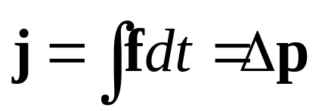
Impulse
An impulse can be thought of as the integral of a force over some time range, which results in a finite change in momentum:
An impulse behaves a lot like a force, except instead of affecting an object’s acceleration, it directly affects the velocity
Impulses also obey Newton’s Third Law, and so objects can exchange equal and opposite impulses
Also, like forces, we can compute a total impulse as the sum of several individual impulses

Slide 29
Compression & Restitution
The collision can be thought of as having two phases: compression & restitution
In the compression phase, the energy of the two objects is changed from kinetic energy of motion into deformation energy in the solids
If the collision is perfectly inelastic (e=0), then all of the energy is lost and there will be no relative motion along the collision normal after the collision
If the collision is perfectly elastic (e=1), then all of the deformation energy will be turned back into kinetic energy in the restitution phase and the velocity along the normal will be the opposite of what it was before the collision

Slide 30
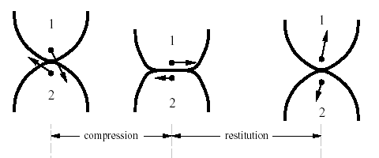
Compression & Restitution

Slide 31
Collisions
Consider the case of a particle colliding with a heavy object. The object is moving with velocity v_{obj}
The particle has a velocity of v before the collision and collides with the surface with a unit normal n
We want to find the collision impulse j applied to the particle during the collision

Slide 32
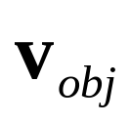

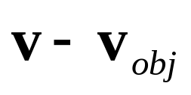
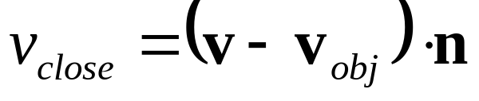
Collisions
We take the difference between the two velocities and dot that with the normal to find the closing velocity
•

Slide 33
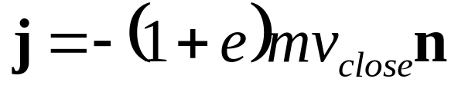
Collisions
Let’s first consider a collision with no friction
The collision impulse will be perpendicular to the collision plane (i.e., along the normal) and will be large enough to stop the particle (at least)

Slide 34
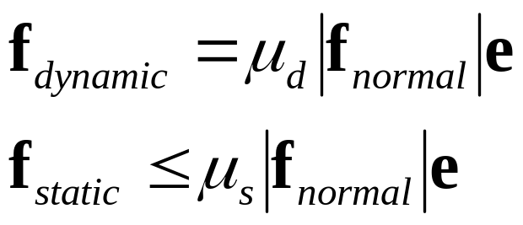
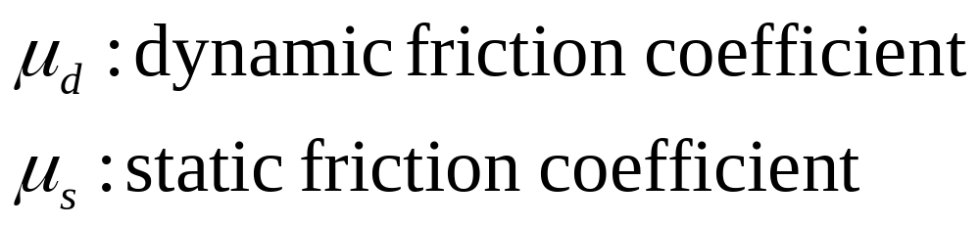
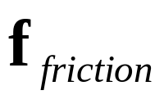
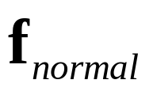
Friction
The Coulomb friction model says:

Slide 35

Friction
As we are not considering static contact, we will just use a single dynamic friction equation
For an impact, we can just compute the impulse in the exact same way as we would for dynamic friction
We can use the magnitude of the elasticity impulse as the normal impulse

Slide 36
Collision Handling
For particles and cloth, the following approach works effectively:
1. Compute forces (springs, aero…)
2. Integrate motion (Euler step)
3. Test if particles hit anything
  3.1 Compute & apply impulse (adjust velocity)
  3.2 Adjust position

Slide 37
Position Adjustment
Moving the particle to a legal position isn’t always easy
There are different possibilities:
  Move it to a position just before the collision
  Put it at the collision point
  Put it at the collision point plus some offset along the normal
  Compute where it would have gone if it bounced
Computing the bounced position is really the best, but may involve more computation and in order to do it right, it may require further collision testing…

Slide 38
Position Adjustment
•
•
•
•
•
•

Slide 39
Bouncing
Computing the bounced position is the best approach, as it is consistent with the rest of the physics model
We need to determine when exactly the collision happened (we can just assume that the particle traveled at a constant velocity within the frame)
We then compute the impulse and adjust the velocity
Then, we move the particle forward by the amount of time remaining within the frame
Ideally, we should then check collisions on this new path
A particle getting stuck in a narrow crack might bounce several times, so we should put a cap on the maximum number of bounces allowed, then just stop the particle at some point if it exceeds the limit

Slide 40
Collision Optimization

Slide 41
Optimization Structures
BV, BVH (bounding volume hierarchies)
  Octree
  KD tree
  BSP (binary separating planes)
  OBB tree (oriented bounding boxes- a popular form of BVH)
  K-dop tree
Uniform grid
Hashing
Dimension reduction

Slide 42
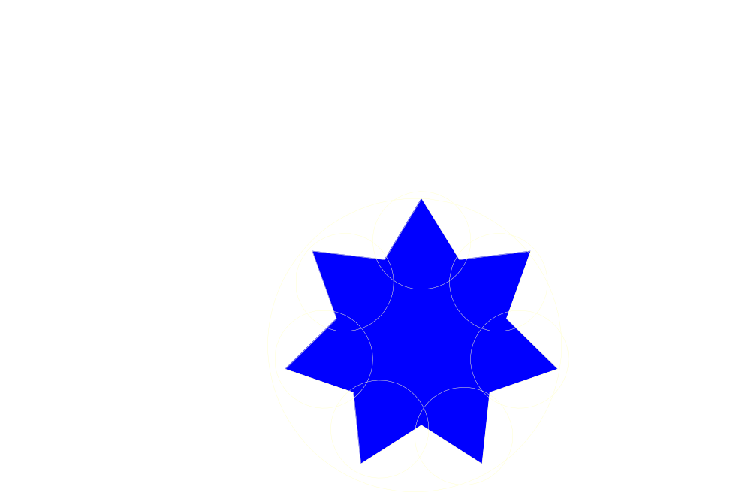
Bounding Volume Hierarchies

Slide 43

Octrees

Slide 44

KD Trees

Slide 45

BSP Trees

Slide 46

OBB Trees

Slide 47
K-Dops

Slide 48
Testing BVH’s
TestBVH(A,B) {
if(not overlap(A_{BV}, B_{BV}) return FALSE;
else if(isLeaf(A)) {
if(isLeaf(B)) {
for each triangle pair (T_{a},T_{b})
if(overlap(T_{a},T_{b})) AddIntersectionToList();
}
else {
for each child C_{b} of B
TestBVH(A,C_{b});
}
}
else {
for each child C_{a} of A
TestBVH(C_{a},B)
}
}

Slide 49

Uniform Grids

Slide 50
Optimization Structures
All of these optimization structures can be used in either 2D or 3D
Packing in memory may affect caching and performance

Slide 51
Pair Reduction
At a minimum, any moving object should have some sort of bounding sphere (or other simple primitive)
Before a pair of objects is tested in any detail, we can quickly test if their bounding spheres intersect
When there are lots of moving objects, even this quick bounding sphere test can take too long, as it must be applied N² times if there are N objects
Reducing this N² problem is called pair reduction
Pair testing isn’t a big issue until N>50 or so…

